Slide 1
Multiplication Check
02.11.2022

Slide 2
National Curriculum
Under the current National Curriculum, children are supposed to know all their times tables up to 12 x 12 by the end of year 4.
The Multiplication Tables Check has been introduced to ensure that children do know their tables.

Slide 3
When will the Multiplication Check be administered?
All the year 4 children will have their multiplication skills formally tested in the Summer Term, usually in June.
We have a 3 week window to complete the test.

Slide 4
How will the MTC data be used?
School level results and individual pupil results will be made available to schools. This will allow schools to provide additional support to pupils who require it.
The school level results will be available to selected users including Ofsted.
National results will be reported by the Department for Education (DfE) to track standards over time.
National and local authority results will be reported by the DfE to allow schools to benchmark the performance of their pupils.

Slide 5
How will the MTC be administered?
Children will be tested using an on screen check (on a computer or tablet), where they will have to answer multiplication questions against the clock.
Wall displays that could provide children with answers will be removed while the MTC is taking place.
Children will have 6 seconds to answer each question in a series of 25 questions.
This allows pupils the time required to demonstrate their recall of multiplication tables, whilst limiting pupils’ ability to work out answers to questions.
Each question will be worth one mark and will be presented in this format: _____ x _____ = ______
The test will last no longer than 5 minutes.
It will be automatically scored, and results will be available to schools once the assessment window closes at the end of the assessment period.

Slide 6
How will the MTC be administered?
Questions will be selected from the 121 number facts that make up the multiplication tables from 2 to 12, with a particular focus on 6, 7, 8, 9 and 12 as they are considered the most challenging.
Each question will only appear once in any 25 question series, and children won’t be asked reversals of questions as part of the check (so if they have already answered 3 x 4 they won’t be asked 4 x 3).
Once the child has inputted their answer, there will be a 3 second pause before the next question appears.
Children will be given the opportunity to answer a couple of practise questions in the format before the check begins.

Slide 7
What is the pass mark for the test?
At present the DfE have not issued an official pass mark.
As a school we are aiming for a pass mark between 23 and 25.

Slide 8
How are we preparing pupils for the MTC?
Through number rocks songs
Times table rockstars
Big Maths, Beat it – CLIC sessions
Counting stick
Multiplication games
Using knowledge of key table facts
Morning starters – daily recall sheets

Slide 9
How can parents support at home?
Access TT Rockstars weekly
Allow children to access the tournaments that will be set up weekly on TTR
Chant the times tables
Play the number rocks songs

Slide 10
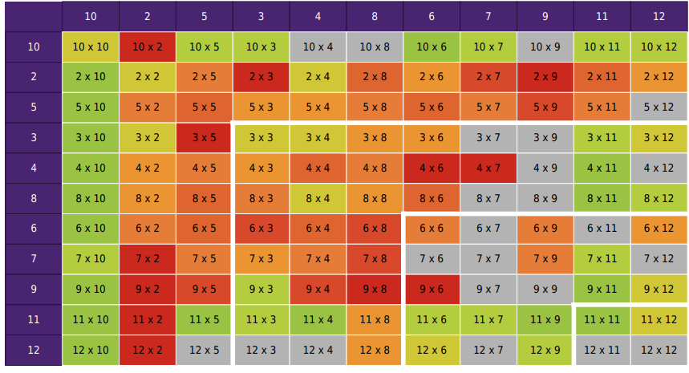
How can parents support at home?
Knowing your children’s gaps

Slide 11
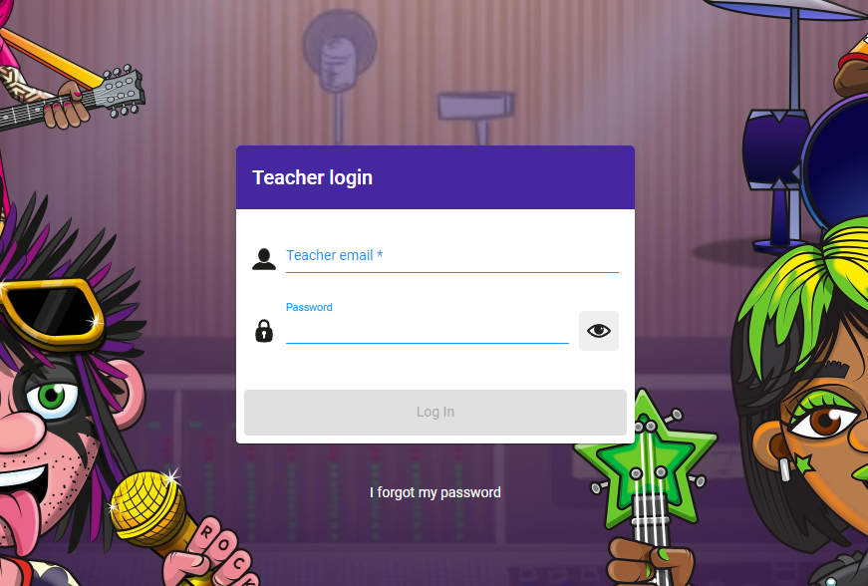
Times Tables Rockstars
Your child has a weekly slot for TT Rockstars. Here they complete the soundcheck and we track this weekly to see the progress the children are making.
This learning platform can be accessed at home – all children have logins

