Slide 1
Austerfield Residential
Thursday 29th – Friday 30th June

Slide 2
Monday 4th July
Children should arrive at school at 8.45am
Children should be wearing clothes that may get dirty or wet
Children should come to their normal classroom with all their belongings for the residential
Children will be registered and we will aim to set off at 9:00am (You are more than welcome to wave us off at the front of school.
Provide your child with a packed lunch for

Slide 3
Packing
Old clothes
Tops and jumpers (including long sleeved)
Trousers/shorts
Underwear and socks
Towel
Toiletries (no sprays)
Trainers x2 (in case one gets wet)
Appropriate footwear
PJs
Warm clothing
Water bottle
Rucksack
Torch
Sun cream

Slide 4
Items not allowed
Any electronic item
Any snack

Slide 5
Medication
If your child requires any form of medication, please inform the office prior to the trip, as a form will need to be signed.

Slide 6
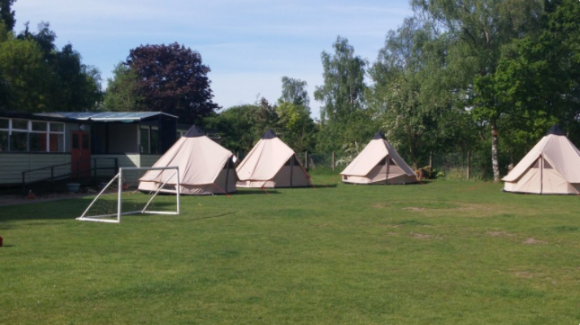
Sleeping arrangements
Prior to the trip, the children will be asked of three friends they would like to be in their tepee. The children will be guaranteed at least one friend from their list of three.
Tepees (6 to a tepee)
Girls and boys will be kept separate.
Teacher tents will be dotted around the entire sleeping area
Children will need to bring their own pillows and sleeping bags

Slide 7
Food
Thursday 29th June
Lunch – Children will take their own packed lunch.
Tea – A pub tea will be delivered to Austerfield for the children to enjoy. A choice of pork sausage, jumbo fish fingers, creamy cheese pasta, creamy ham pasta, chicken nuggets and margarita pizza.
Friday 30th June
Breakfast – a buffet breakfast, including cereal and toast.
Lunch – Sandwiches will be provided with a choice of ham, jam, cheese and tuna.
Teas and lunches will be pre ordered before the trip.

Slide 8
Staying away from home
We want all the children to enjoy this residential.
Children who are attending the trip are attending the whole trip.
Children can bring a comfort with them.

Slide 9
Itinerary
Day one
Welcome game
Introduction to activity number one
12pm – 1pm – Lunch (brought from home)
1.30pm – 3.30pm – Activity number two
3.30pm – 5pm – Tea (from the pub)
6.00pm – 8pm – Free time
Day two
Approximately 9am – Breakfast
Move bags to a safe room
9.30am – A re-run from the day before
2.30pm – Leave Austerfield
3.15pm – Arrive at Brooke

Slide 10
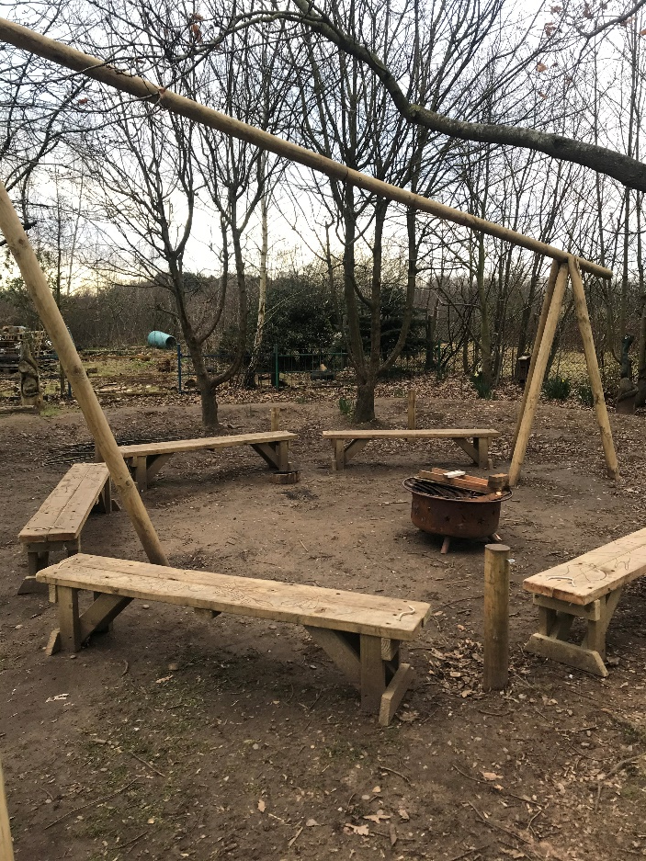
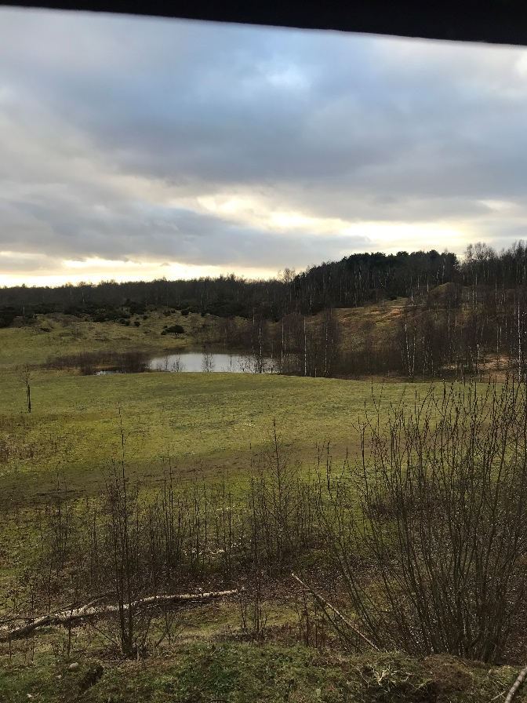
Activities
Marvellous Minibeasts
Orienteering
Team Building
Wild Art

Slide 11
Payment
£54 per child
All balances are to be fully paid by 1st May.
Payment should be made on the new ParentMail app under section ‘Payments’ then ‘Shop’.
If anyone needs any help, please contact the office.

Slide 12
Not attending the residential
If your child is not attending the residential, they are expected to still come to school.
They will be taught in a different classroom by another member of staff.

Slide 13
Finally…
Please ensure their names are on every item that belongs to them.

Slide 14
Questions…

