Slide 1
Austerfield Study Centre Residential
Thursday 23rd –
Friday 24th May 2024
Parents meeting
Monday 25th September 2023

Slide 2
Itinerary
Day one
Welcome game
Introduction to activity number one
12pm – 1pm – Lunch (brought from home)
1.30pm – 3.30pm – Activity number two
3.30pm – 5pm – Tea (brought from the pub)
6.00pm – 8pm – Free time
Day two
Approximately 9am – Breakfast
Move bags to a safe room
9.30am – A re-run from the day before
2.30pm – Leave Austerfield
3.15pm – Arrive at Brooke

Slide 3
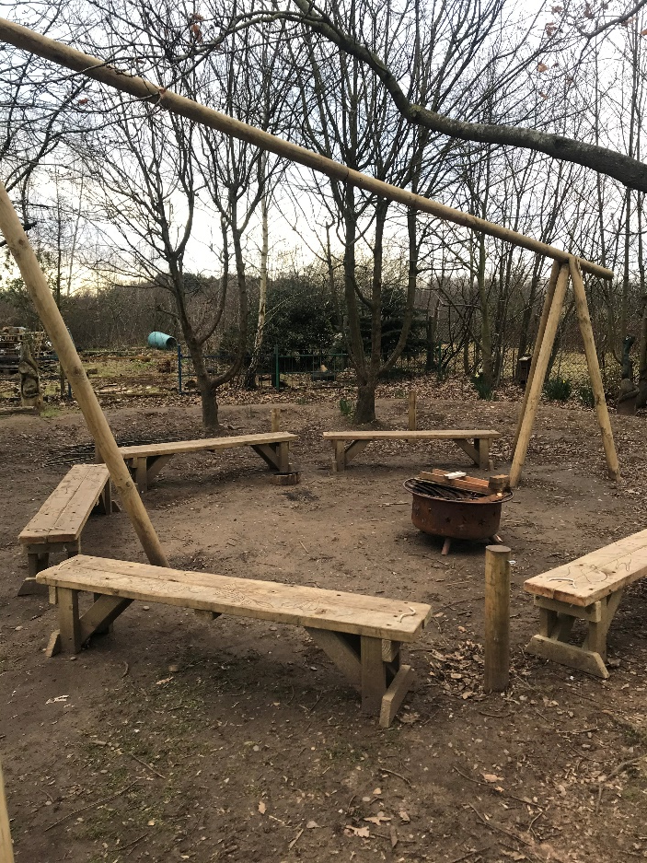
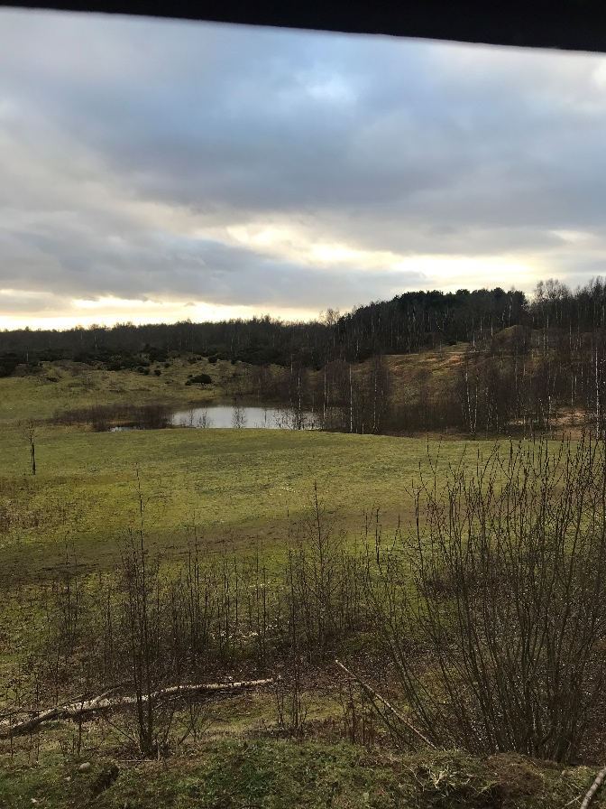
Possible Activities
Marvellous Minibeasts
Campfire sing along
Team Building
Orienteering
Wild Art

Slide 4
Food
Thursday 23rd May 2024
Lunch – Children will take their own packed lunch.
Tea – A pub tea will be delivered to Austerfield for the children to enjoy. The choices are likely to be pork sausage, jumbo fish fingers, creamy cheese pasta, creamy ham pasta, chicken nuggets and margarita pizza.
Friday 24th May 2024
Breakfast – a buffet breakfast, including cereal and toast.
Lunch – Sandwiches will be provided the choices are likely to be ham, jam, cheese and tuna.
Teas and lunches will be pre ordered before the trip.

Slide 5
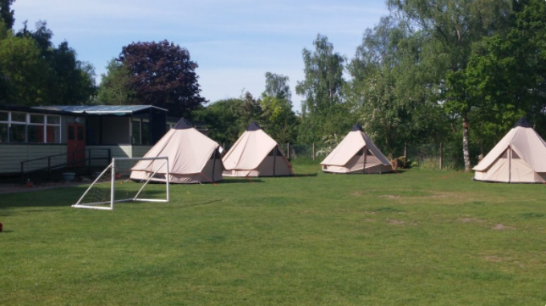
Sleeping arrangements
Prior to the trip, the children will be asked of three friends they would like to be in their tepee. The children will be guaranteed at least one friend from their list of three.
Tepees (6 to a tepee)
Girls and boys will be kept separate.
Teacher tents will be dotted around the entire sleeping area.
Children will need to bring their own pillows and sleeping bags.

Slide 6
Thursday 23rd May
Children should arrive at school at 8.45am
Children should be wearing clothes that may get dirty or wet
Children should come to their normal classroom with all their belongings for the residential
Children will be registered and we will set off at 9:00am (You are more than welcome to wave us off at the front of school.
Provide your child with a packed lunch for dinner on this day

Slide 7
Packing
Old clothes
Tops and jumpers (including long sleeved)
Trousers/shorts
Underwear and socks
Towel
Toiletries (no sprays)
Trainers x2 (in case one gets wet)
Appropriate footwear
Warm pyjamas
Warm clothing
Water bottle
Rucksack
Torch
Sun cream

Slide 8
Items not allowed
Any electronic item
Any snack other than their packed lunch for Thursday

Slide 9
Medication
If your child requires any form of medication, please inform the office as soon as you can prior to the trip, as a form will need to be signed and staff notified.

Slide 10
Staying away from home
We want all the children to enjoy this residential.
Children who are attending the trip are attending the whole trip.
Children can bring a comfort with them.

Slide 11
Payment
£71 per child
All £10 deposits must be paid by Wednesday 1st November 2023.
Payment should be made on the ParentMail app under section ‘Payments’ then ‘Shop’.
If anyone needs any help, please contact Mrs Whitfield or Mrs Cuttell in the school office.

Slide 12
Not attending the residential
If your child is not attending the residential, they are expected to still come to school.
They will be taught in a different classroom within an alternative class by another teacher.

Slide 13
Finally…
Please ensure that your child’s NAME is ON EVERY ITEM that belongs to them.

Slide 14
Thank you for coming and we hope to see all our Year 4 children at Austerfield next summer.

