Slide 1
PGL Residential Trip 2024

Slide 2
PGL – What is it?
Just ten miles north of Grantham, there’s over 65 acres of space for your children to enjoy at Caythorpe Court, packed full of adventure activities on land and water. From high ropes to the giant swing, each challenge will help pupils reach further and achieve more.
The 3-day, 2-night residential will take place on Wednesday 11th September
to
Friday 13th September 2024
The price of the trip per child will be £295. The price will include accommodation, activities, breakfast, lunch, dinner, supper, bedding and transportation. The only additional cost to parents will be if they wish to provide a little spending money.

Slide 3
PGL – Why should I go to PGL?
Build relationships
Develop perseverance
Demonstrate team work
Improve their social skills
Challenge themselves
Take risks

Slide 4
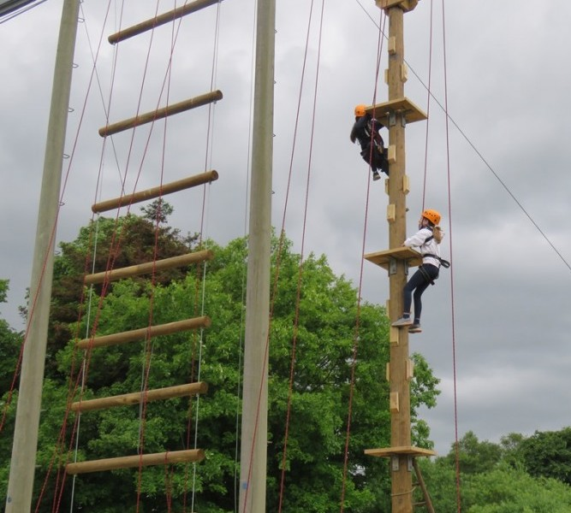
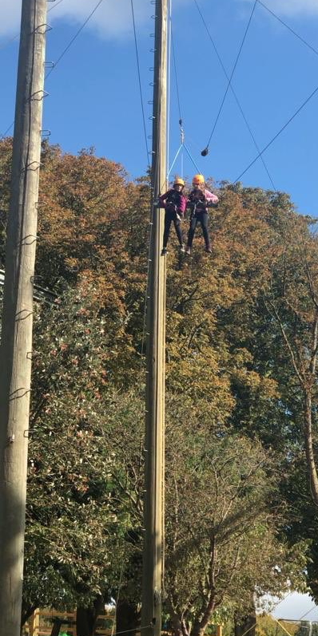
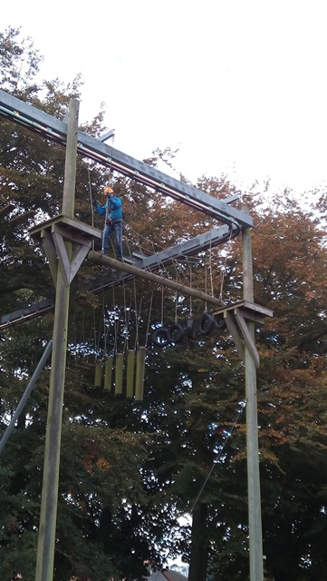
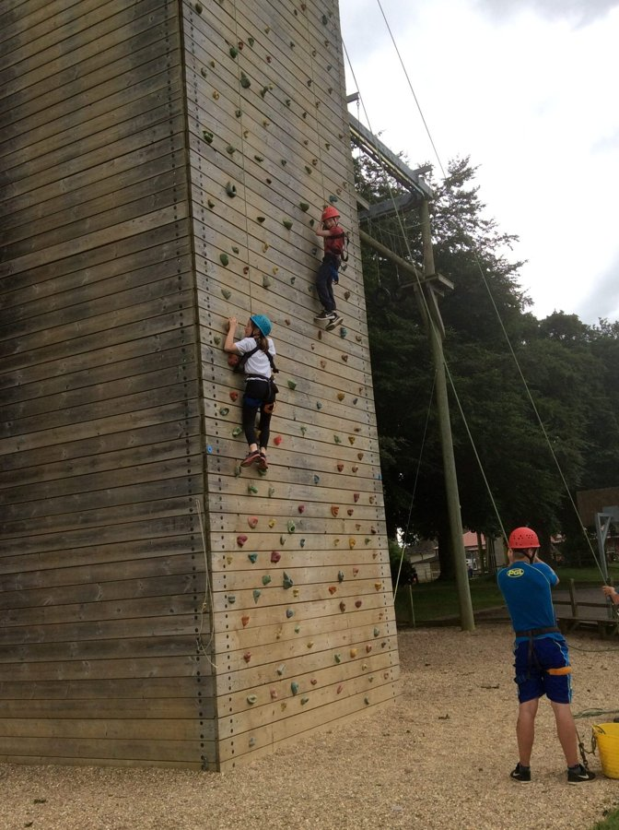
PGL – The Activities
All activity sessions are led by well trained, enthusiastic instructors and are specially designed to motivate, build confidence and encourage development in pupils.

Slide 5
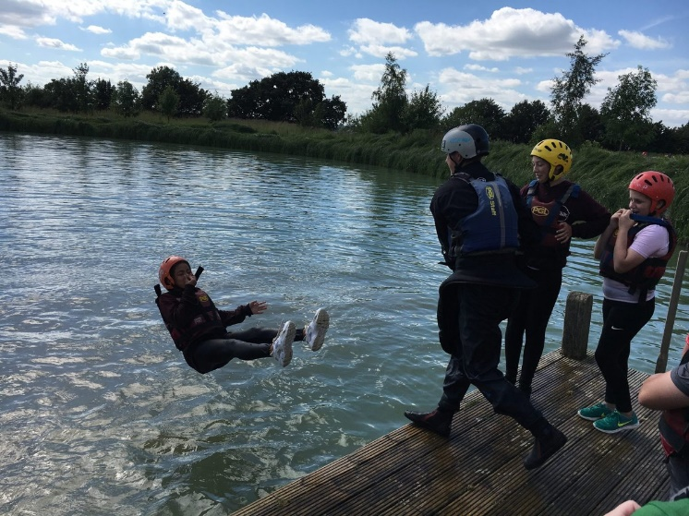
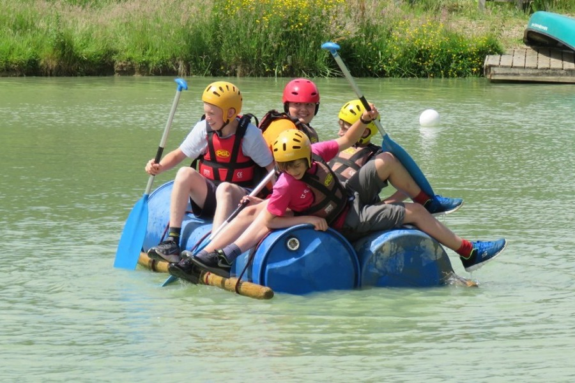
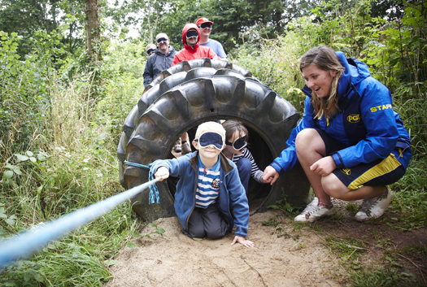
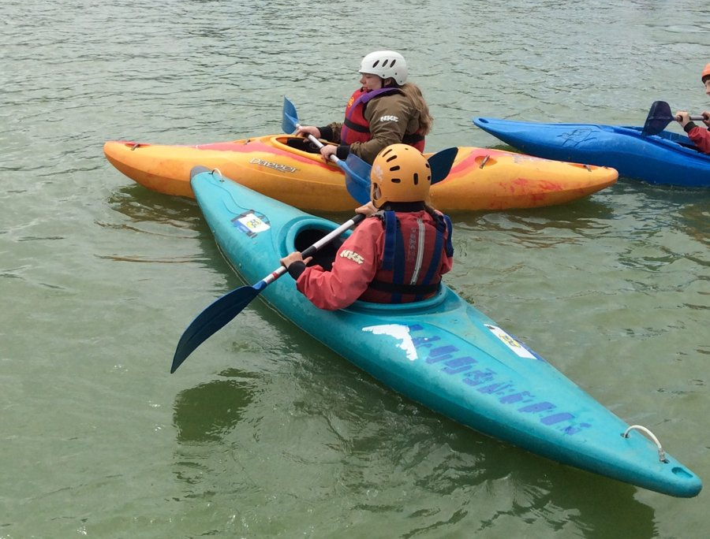
PGL – The Activities

Slide 6
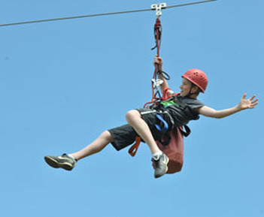
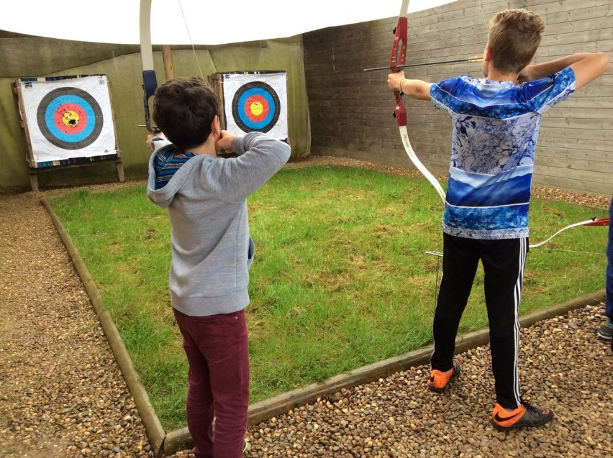
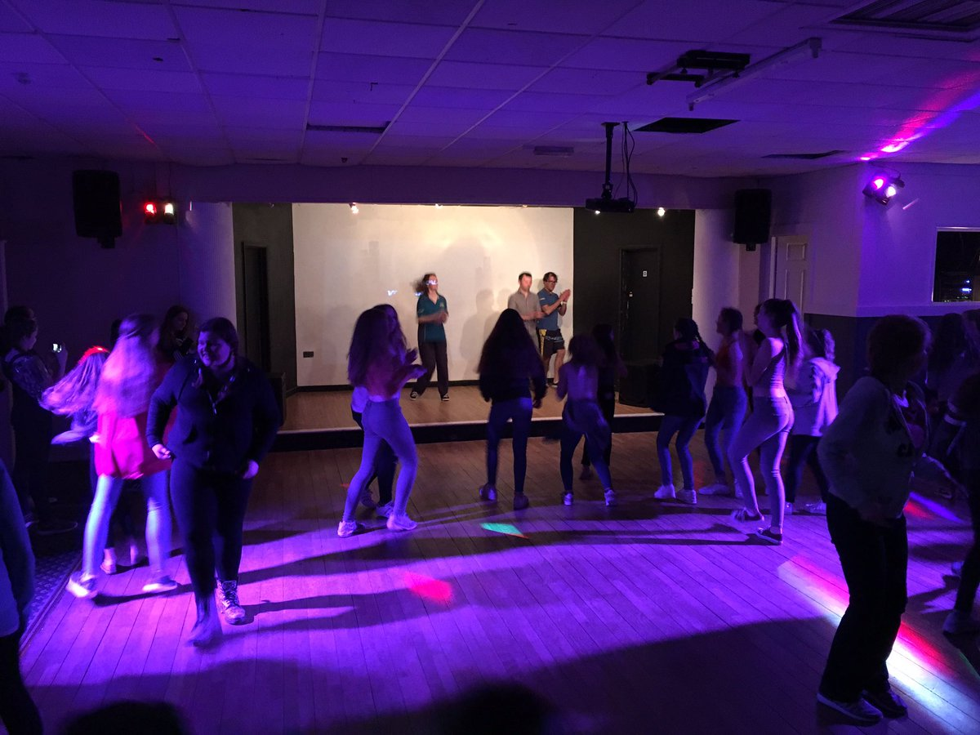
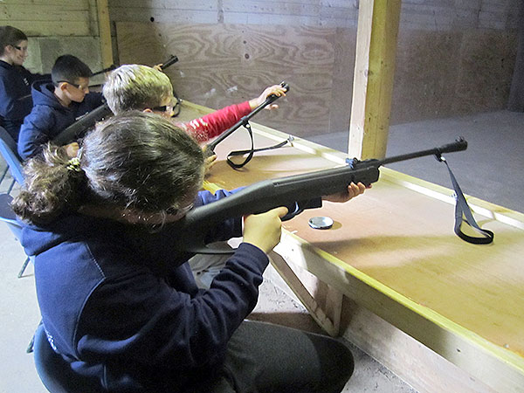
PGL – The Activities

Slide 7
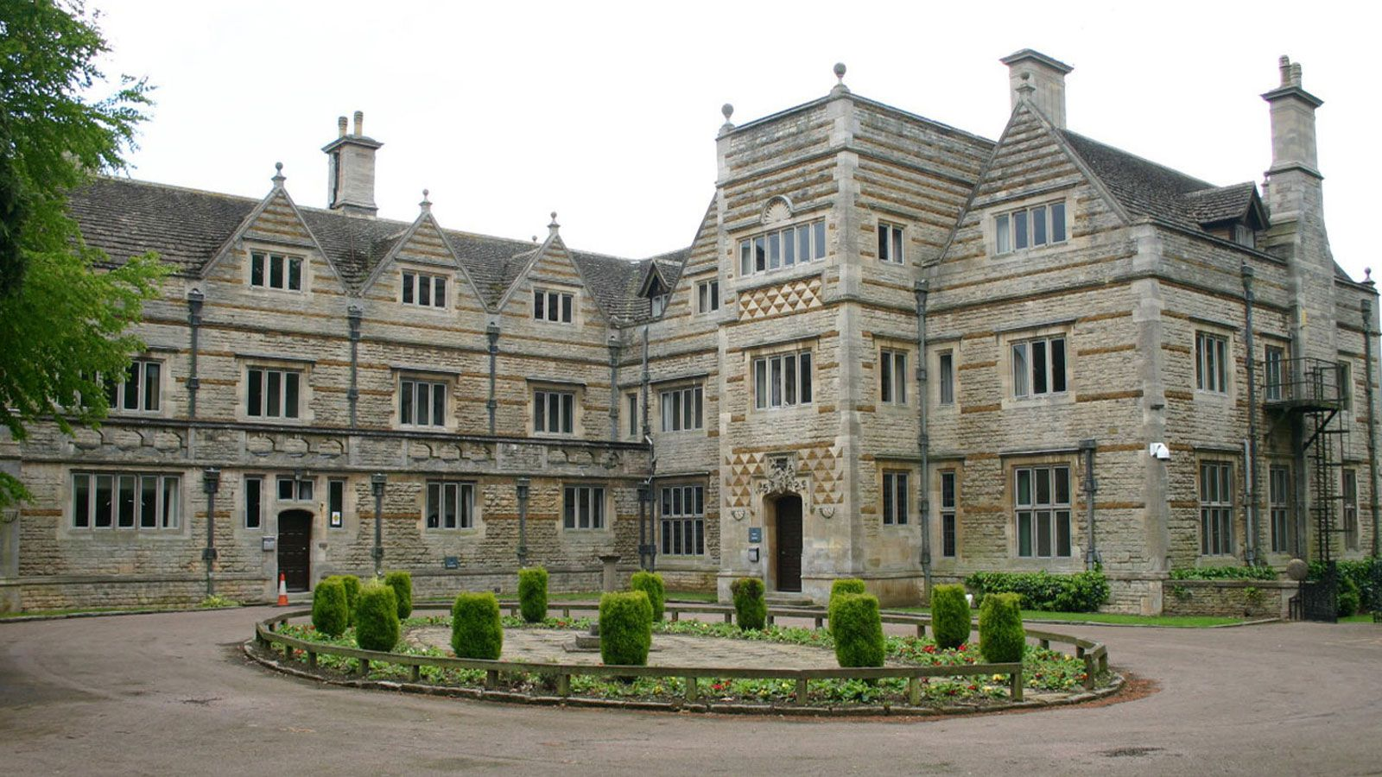
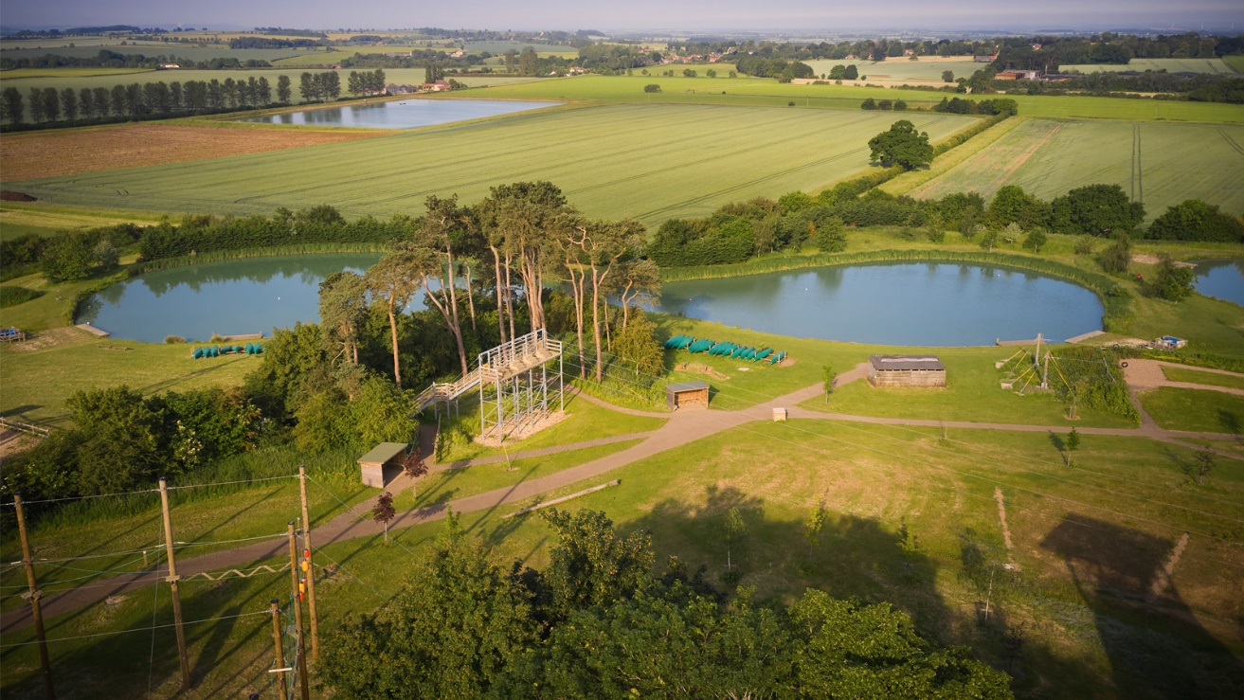
PGL – The Grounds
Over 65 acres of space for your children to enjoy.
Safe!

Slide 8
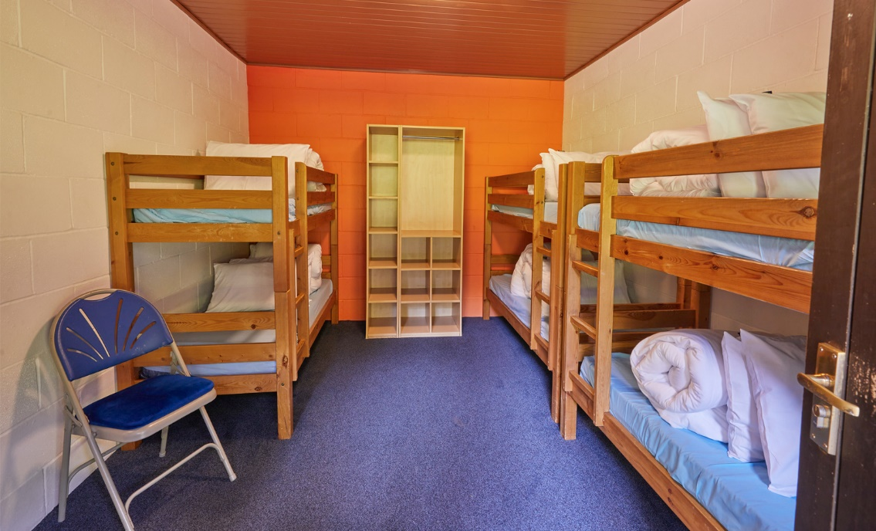
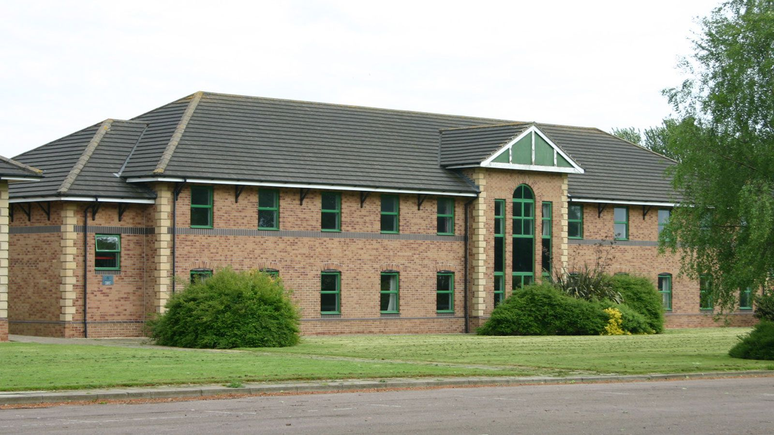
PGL – The Accommodation
Dormitory-style rooms in a range of accommodation blocks and lodges.
Pupils - En suite rooms with bunk beds sleep 3-8

Slide 9
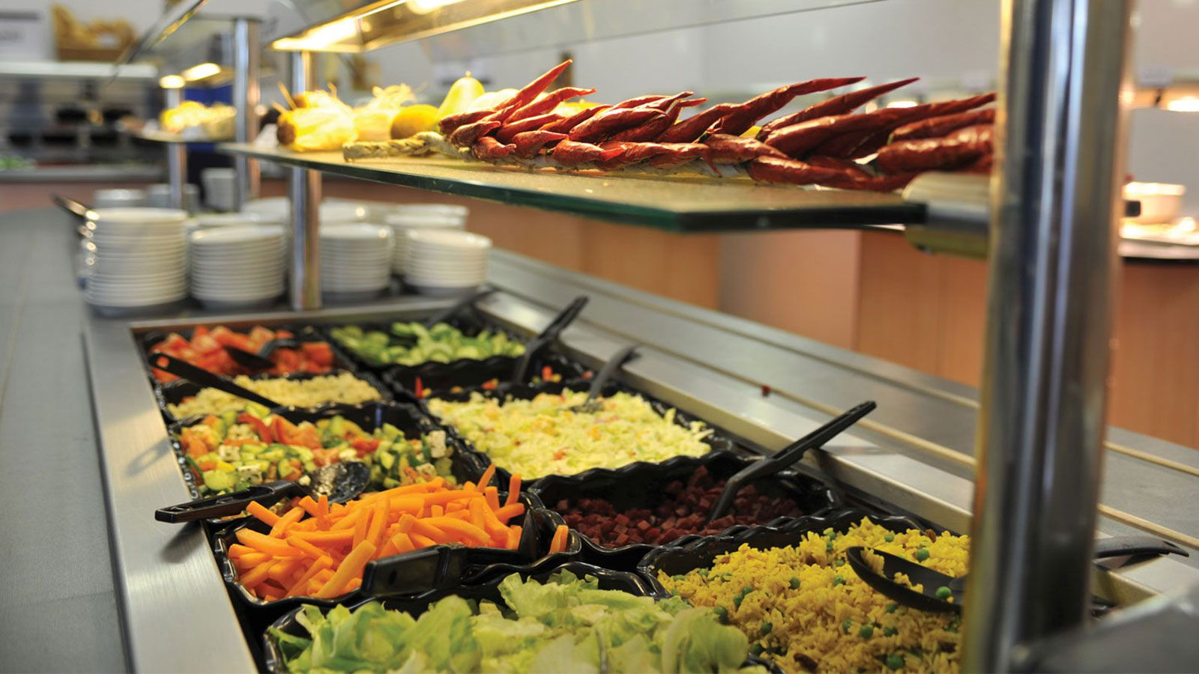
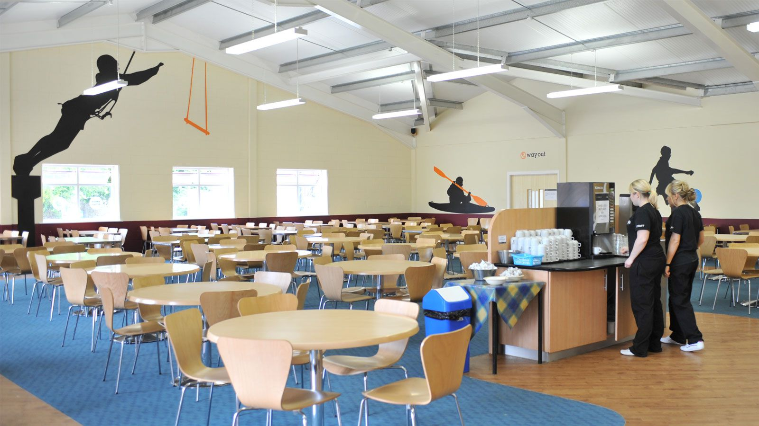
PGL – The Food
All meals are freshly prepared, balanced and will give your child plenty of energy to keep them going throughout the day.
A mix of hot and cold meals with vegetarian options
Self-service salad bar
Fresh fruit with every meal
Allergies, intolerances and special diets catered for

Slide 10
PGL – A Typical day at PGL

Slide 11
PGL – What will I need?

Slide 12
More information
Visit the website

Slide 13
So what now?
If you want your child to go, please take and complete the letter.
If you have any questions regarding the trip please contact the school office in the first instance.

